Slide 1
Veryan Parent forum
16.10.18

Slide 2
Welcome:
All concerns raised have been taken into consideration when planning for this parent forum. I want this to be a positive, constructive event where I can make you aware of any changes, polices, plans or show to you that your feedback is being acted upon. This isn’t a platform to discuss individual children. At the end of this session there will be a 15 minute slot allocated for you to take up any specific issues or concerns with the relevant members of staff privately.

Slide 3
School Priorities
KPI 1 - In EYFS ensure that 85.7% of pupils achieve GLD
KPI 2 - Ensure rapid progression of pupils in Maths, Reading and Writing to ensure pupils achieving ‘expected’ progress rises to 75%.
KPI 3 - Increase the amount of pupils achieving ARE in Reading, especially boys achieving expected attainment in reading to ensure 75%

Slide 4
KPI 1: In EYFS ensure that 85.7% of pupils achieve GLD
Appointment of Miss Goodall- EYFS specialist
Daily RWI phonics
Daily maths skills
Play Dough Rock- Fine motor skills
Daily writing tasks
Encouraging independence
Introduce systems used across the school to aid transition
High expectations across the board
Immersing children amongst challenge and choice daily

Slide 5
KPI 2: Ensure rapid progression of pupils in Maths, Reading and Writing to ensure pupils achieving ‘expected’ progress rises to 75%.
Same day intervention
Spelling Shed
Mr Hall – Ex maths teacher every Tuesday morning to work with small groups with a reading and maths focus
Timetable Rock Stars
Maths Whizz
Tailored intervention
Guided Reading- Whole class (reciprocal), group based guided reading
Reading Karate
Class book read
Book talk

Slide 6
KPI 3: Increase the amount of pupils achieving ARE in Reading, especially boys achieving expected attainment in reading to ensure 75%
Tailored intervention
Guided Reading- Whole class (reciprocal)/ group based guided reading
Reading Karate
Class book read- ‘Sputniks Guide to life, Who let the Gods out, Broccoli boy’
Book talk
Volunteer readers
Systematic phonics daily- Progress already been seen as a result of this.
Display words around classrooms
Reading challenges
Daily readers in class
Spelling Shed linked to weekly spelling list.

Slide 7
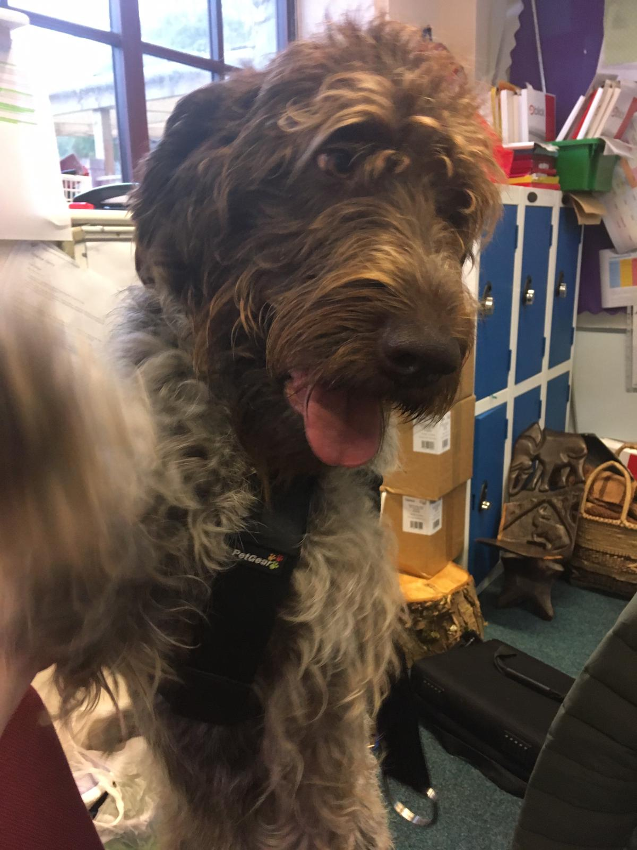
Rita the Learning Assistant Dog:
Apologies…
We whole heartedly apologies for how abruptly you were introduced to Rita. Our intention was to notify you of her arrival well in advance of it happening but for one reason or another we were unable to do that.
However…
Rita’s timetable:
Currently in Tuesday, Wednesday and Friday’s
How are we allowed to have a dog in school?
Fully trained.
Fully vaccinated.
Behaviour has been assessed by dog handler.
Insurance.
Risk assessment.
Pets in the work place policy CCE.
Miss Goodall’s disclaimer.

Slide 8
Why?
Main benefits
Children learn skills that result in better connection and relationships
physical benefits including lower blood pressure, reduced anxiety, increased self esteem, a tendency to forget about insecurities and limitations, increased immune system
socio-emotional support that facilitates coping, recovery, and resilience and offer comfort, affection, and a sense of security
The presence of a companion dog in Carne class especially has helped the children to build trust in their new teacher in a relatively short period of time following a period of inconsistency, which has meant they are more relaxed and motivated to engage in their learning far earlier into the term .
Additional child/ need specific benefits;
Increased effectiveness of thrive/TIS activities with the presence of the dog
Physical therapy assisted by the dog for children with sensory processing needs

Slide 9
Mr Tyers job share and recruitment:
Why did Miss Linnell leave?
Role of HLTA when covering:
Under the ATL guidance HLTA’s are able to: plan and prepare lessons and courses for pupils. Deliver lessons to pupils; this includes delivery via distance learning or computer aided techniques and whole class lessons. Assessing the development, progress and attainment of pupils. Reporting on the development, progress and attainment of pupils.
How was she allowed to leave at such short notice?
What will happen in the short term?
When will the recruitment process take place?
Through what avenue will this person be employed?

Slide 10
Attendance letters:
In the next few days you will receive a letter in regards to your child’s attendance. On that letter will be:
Attendance for this term so far. Given as a percentage.
Explanation for the governments expectation for national attendance
Policy for those children who have less than 93% (93% or below qualifies for persistence absence).
A letter will also go out to notify those above nation average (National Average being 96.1%).
Why?

Slide 11
Residential plans: Eden Project
To ensure that the cost remains as low as possible we will be asking that parents drop off and collect from Eden. This residential will be for years 5,6. Next years residential will be for years 4,5,6 and will be back at Ashburton.
Arrival – 10.00 Thursday 27th June
Finding Fibonnaci – 10.30 – 12.30
Storm Patrol – 13.00 – 16.00
Pop back up to YHA sort rooms
Sustainium Quiz – 18.30 – 20.30
Friday 28th June
Packaging Patrol – 9.30 – 11.30
Two hour workshop – 12.30 – 14.30
The cost per child will be £79.80/£54.80 – all activities, 1 nights accommodation, entrance and vat.
[Discussion with PFA to take place regarding any additional funding they are
willing to contribute and I will notify you all when that has taken place]

Slide 12
Parents evening plans:
12th Novemeber starting 2pm-5:30pm
13th November starting 2:30pm- 6:00pm
Parents evening will take place in Kiberick 2. Parents evening is a time where the success of your children is discussed and if you wish to talk about more ‘delicate’ matters then please book in a time to do so with the class teacher at an appropriate time.

Slide 13
Success so far!
Maths audit conducted by a leading Ofsted inspector.
Trip to Newquay Zoo!
Rita
Successful start to Friday club
Cornish Pirates
Miss Danks- High quality teaching provision
Accelerated progress within Phonics
Roseland Sport fixtures
The drop of and pick up in the morning (big thanks to the gate)

Slide 14
Safeguarding:
Mr Tyers is the Safeguarding Lead for the school
Miss Goodall is the deputy safeguarding lead for the school
Mobile phones: In the event of trips etc. Photos may be taken on staff phones but once up loaded to school computer they are always deleted immediately.
At times mobiles are used to upload images (never including children) to twitter during lesson. This will change for next year. Only school iPads will be used to take photos with and upload to twitter.
There is a strict no phones out in lesson time, they should be kept in draws or bags until lunch or break and will be consistently reinforced next year.
All visitors are required to place their mobile device in a white basket which is then kept in our safe for the duration of their visit.
It may appear that we have been somewhat ‘slap-dash’ with this but please rest assured it will be a priority moving forward.

