Slide 1
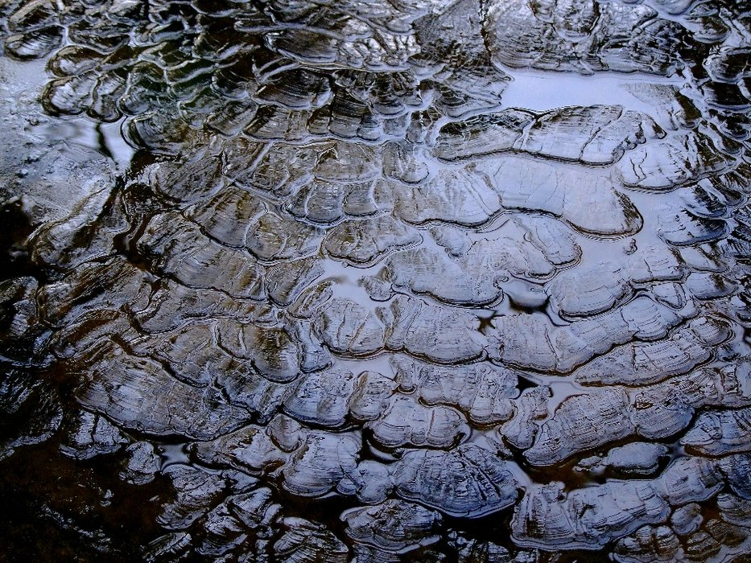
Texture
Art concepts
Notes:
What do we mean by texture when we talk about art?
Texture in a painting is the feel of the artwork.
e.g. It can be based on the paint, and its application and manipulation
or
the addition of materials such as metal, wood, lace, leather and sand.
Texture in painting stimulates two different senses, visual and tactile.

Slide 2
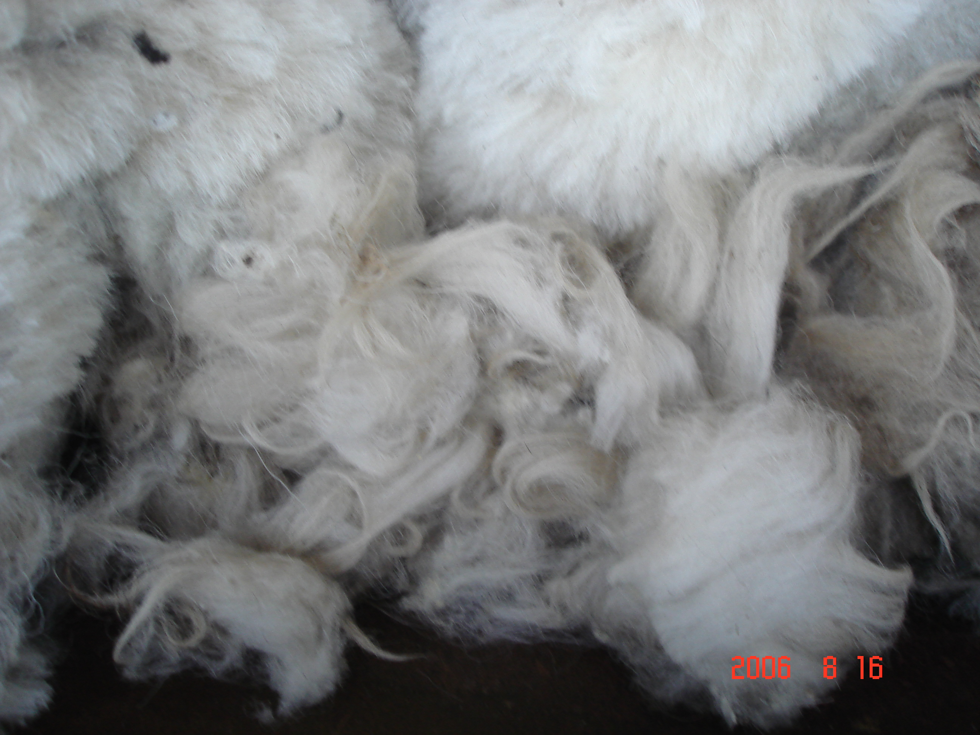
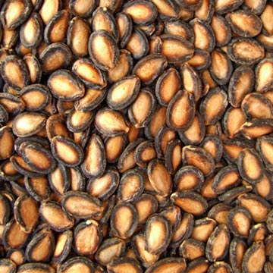
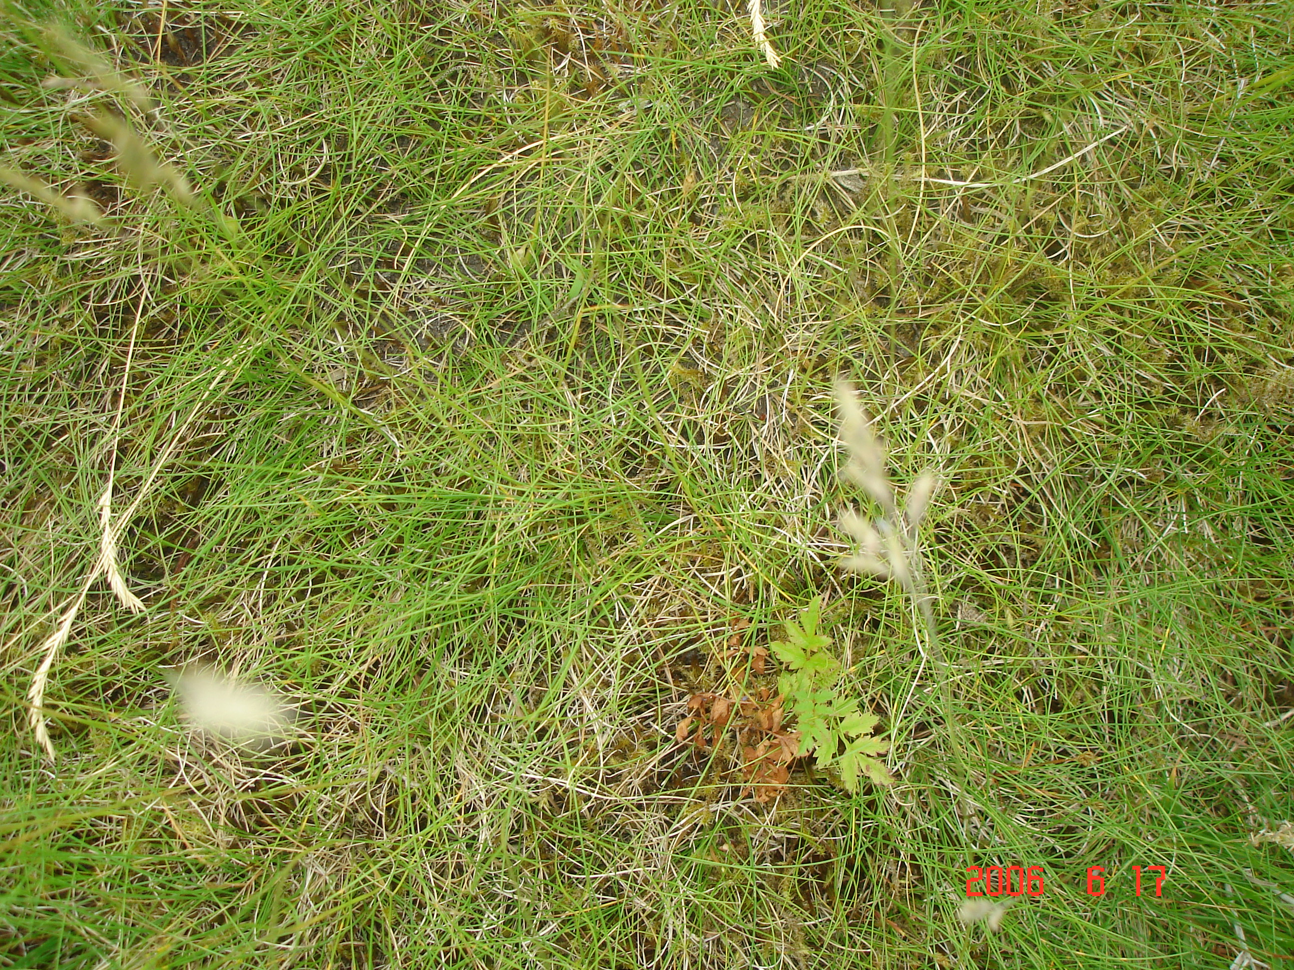
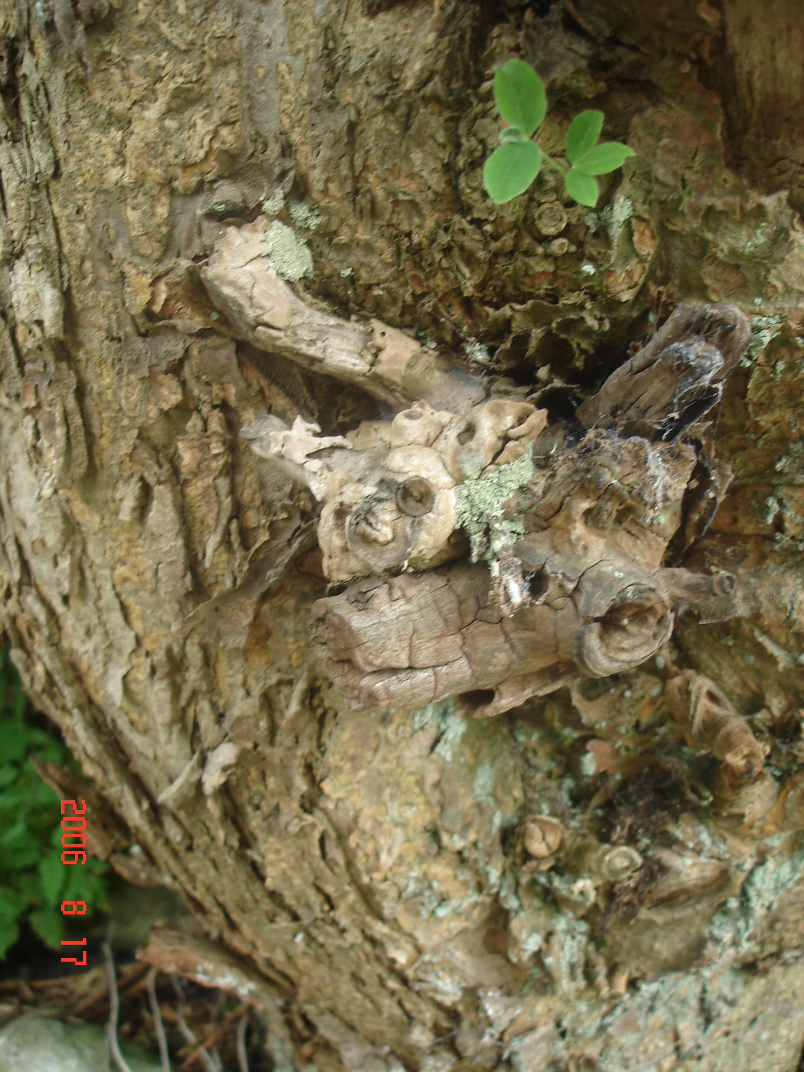
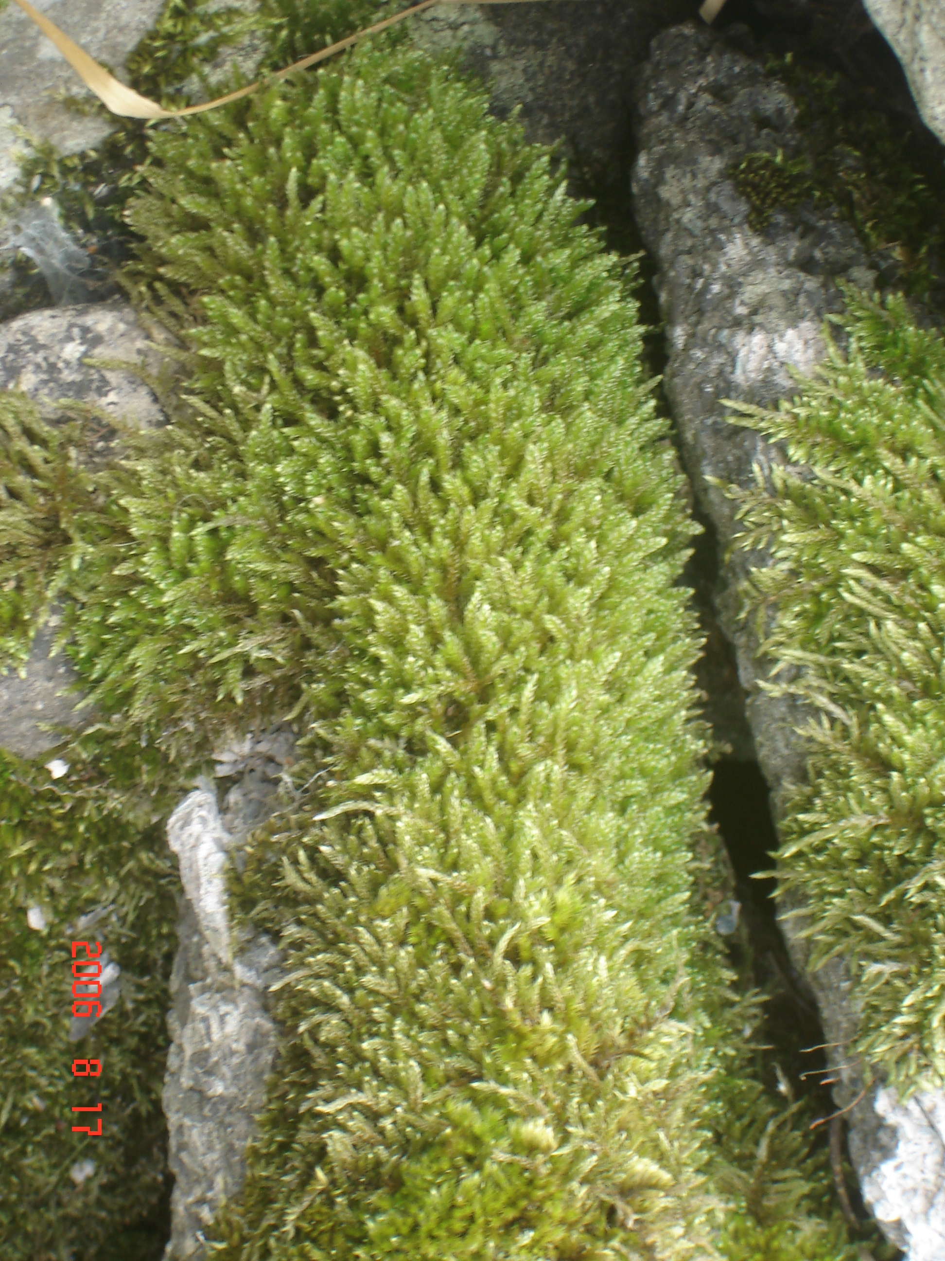
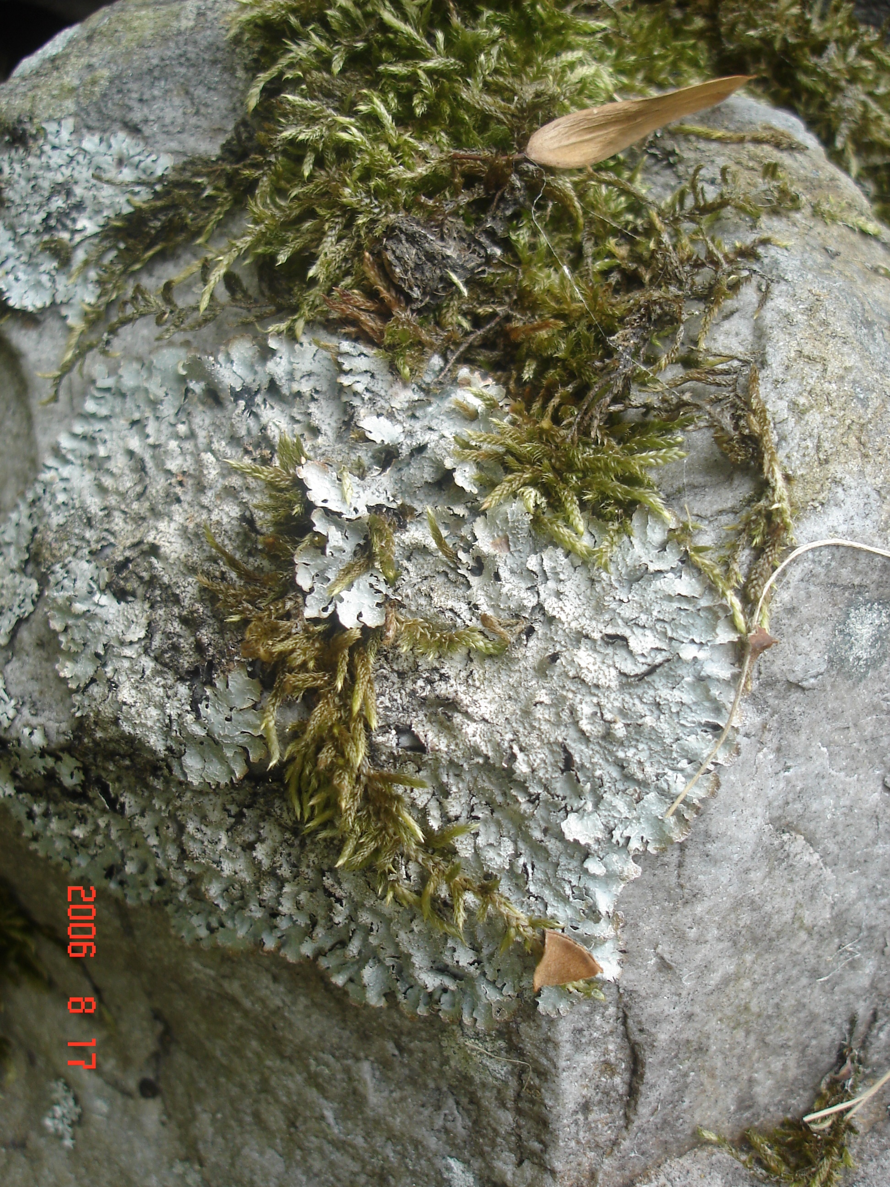
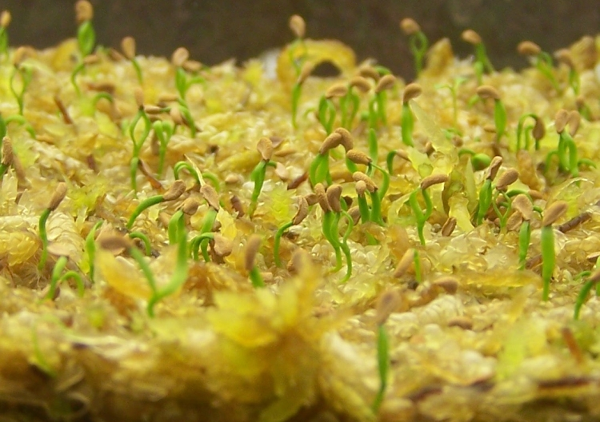
Describe the texture
Notes:
Describe the texture
Discuss the use of more complex words and deeper thought.
Instead of Smooth, rough, soft, sharp, spiky
Maliable, course, crumbly, firm
also be aware of the misconceptions between describing the object ie mossy, sandy and describing the texture.
IDEAL ANSWERS:

Slide 3
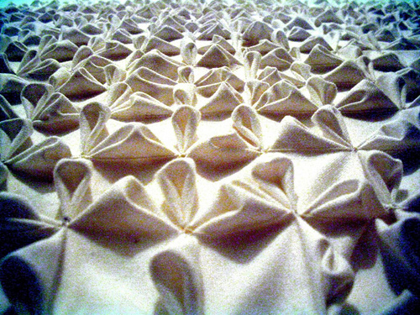
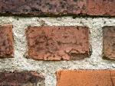
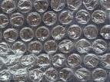
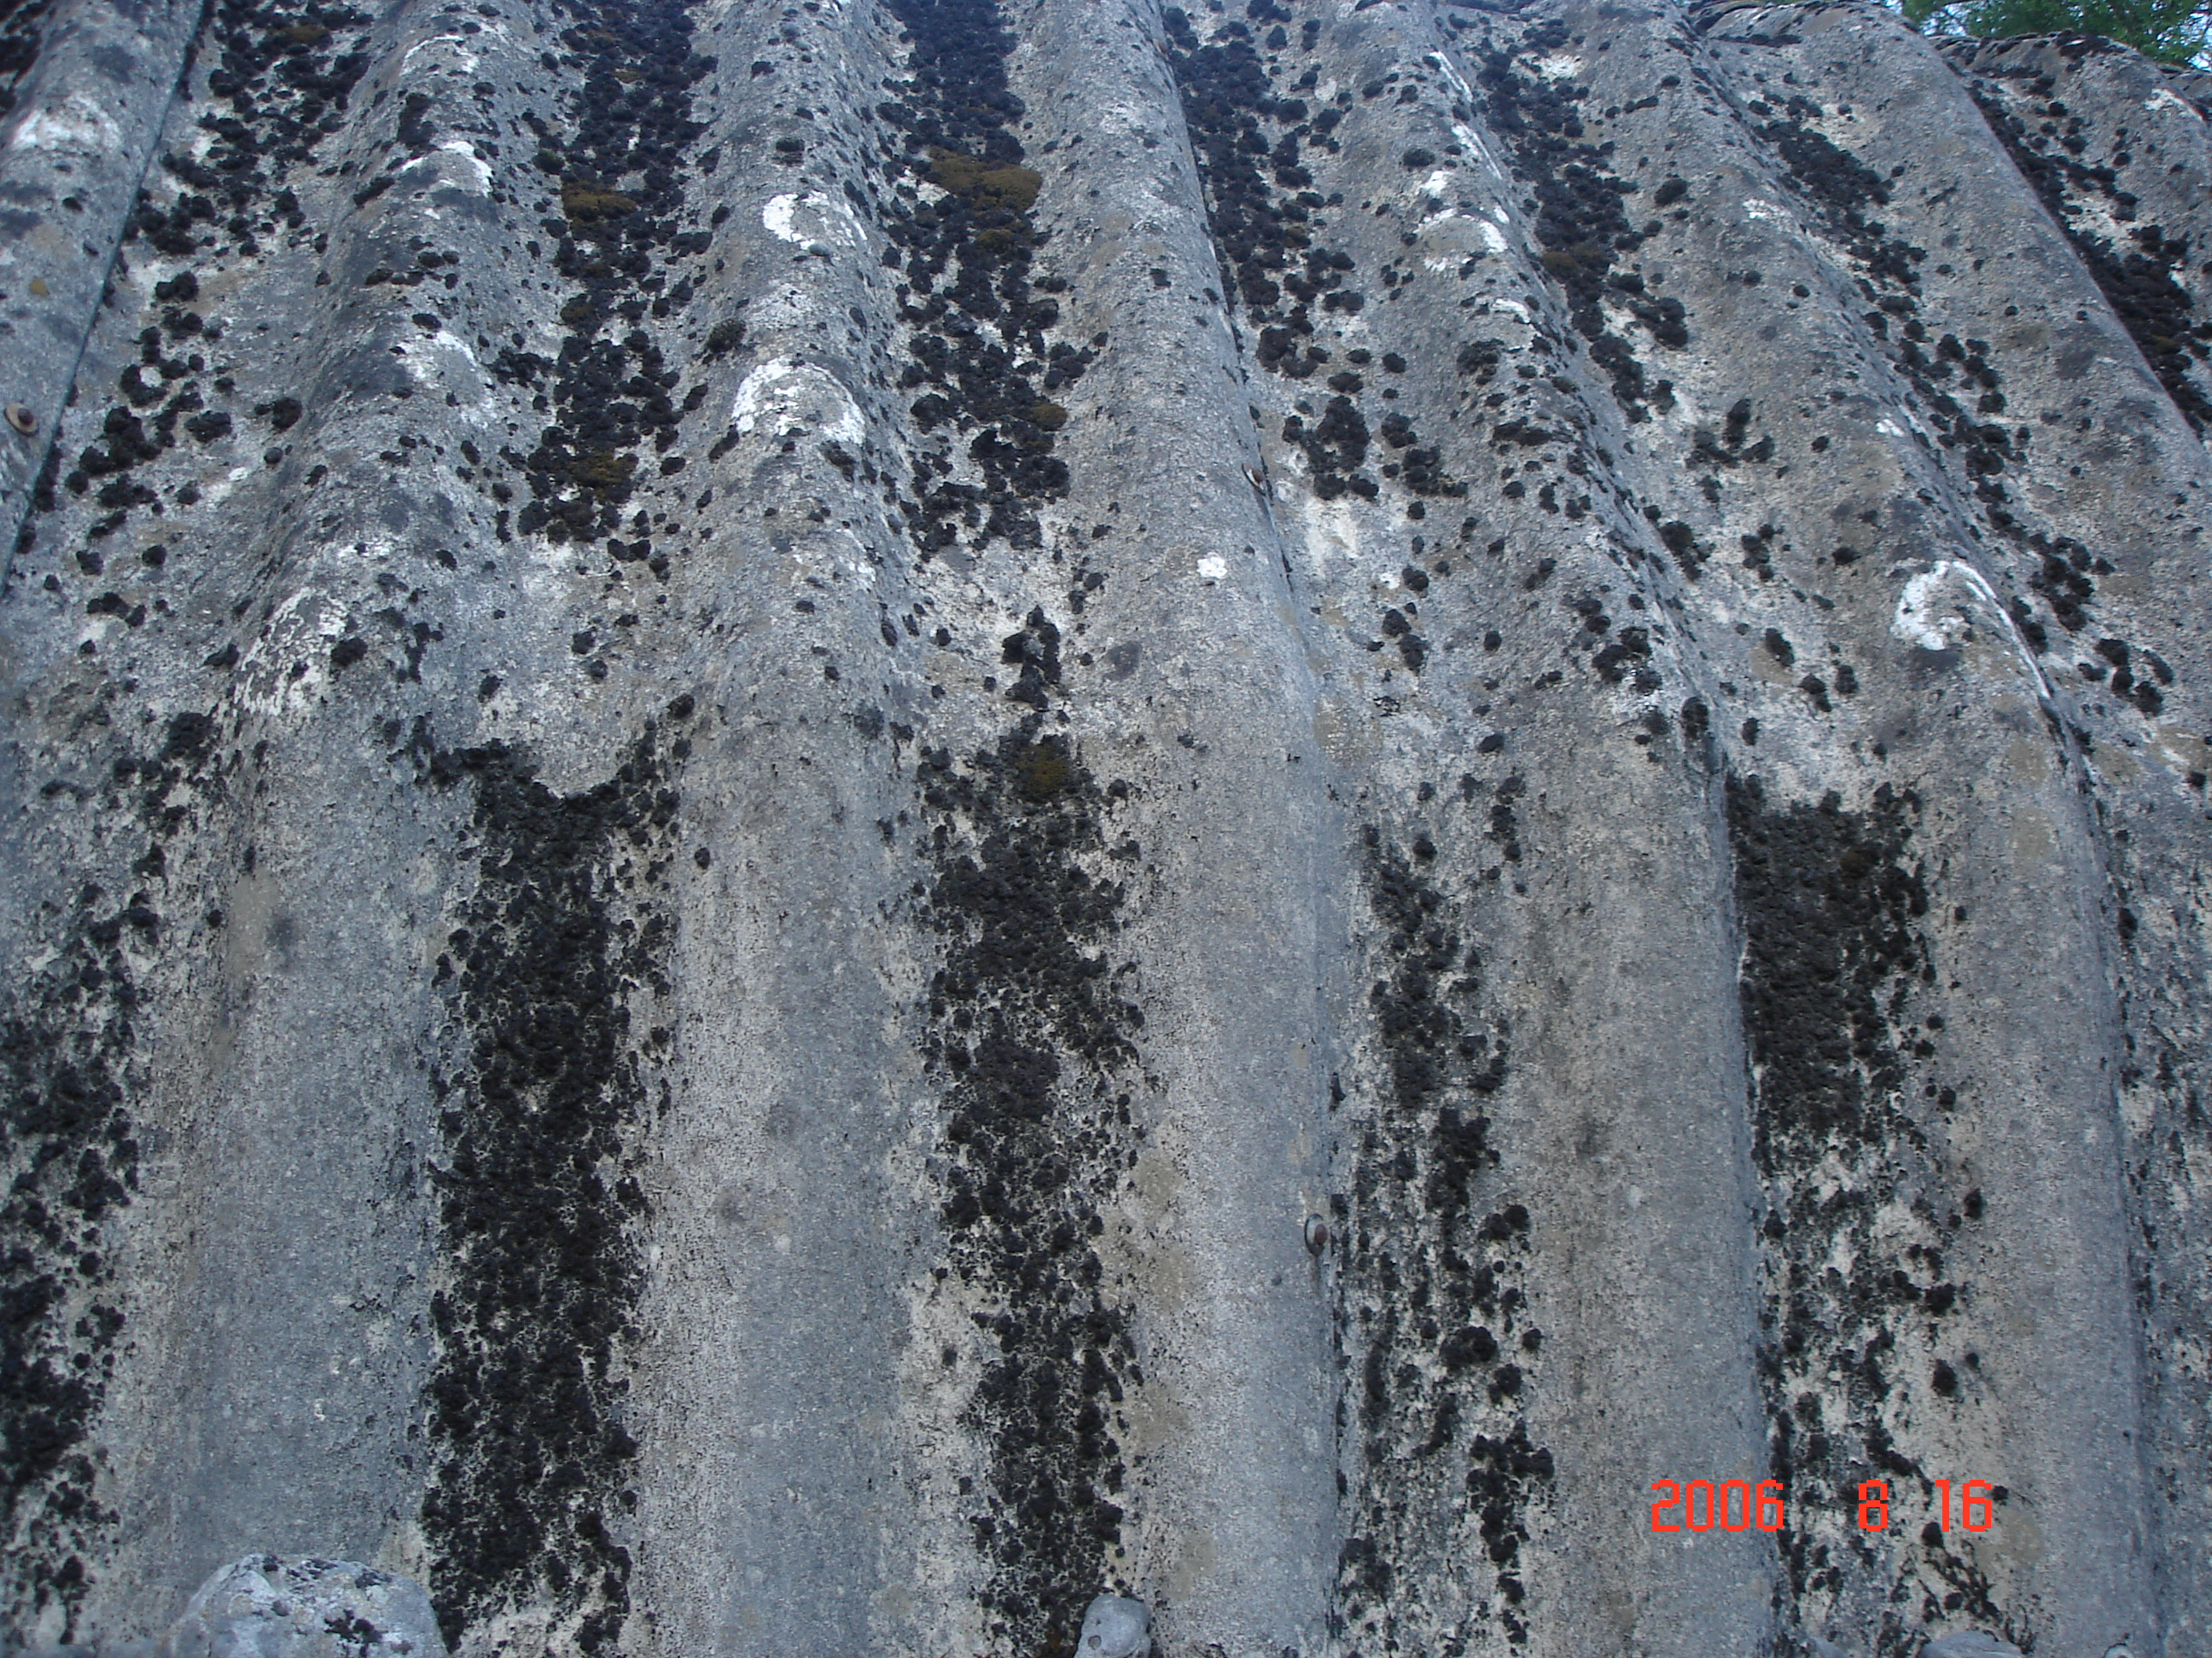
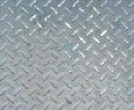
How can you tell?
Notes:
Discuss how you can tell what kind of textures there are simply by looking.
What visual clues are there?
Personal experience allows you to understand the experience but what visual clues allow you to understand what that experience will be
IDEAL ANSWERS:

Slide 4
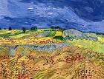
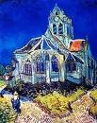
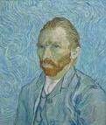
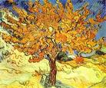
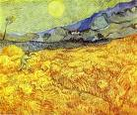
Van Gogh
Notes:
Discuss the texture these artists use, how have they achieved this? How would it feel?

Slide 5
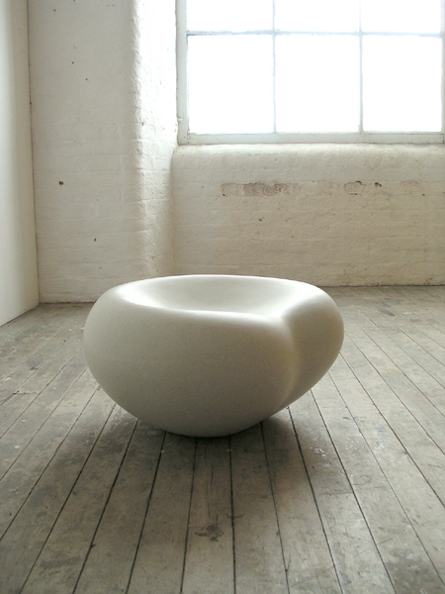
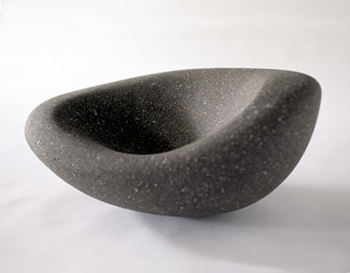
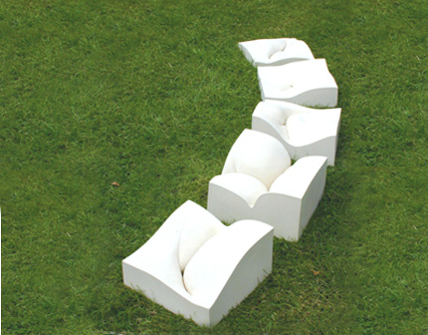
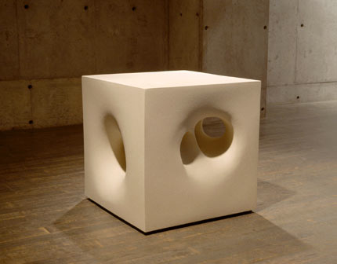
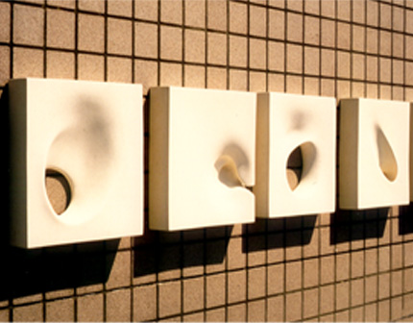
Mari Ruth Oda
Notes:
How would you describe the texture mari ruth oda uses here?
Discuss how each would feel like to touch/hold.
Although they are all smooth what would be different?

